Slide 1
Red Hat IT’s
DevOps Journey:
Year One Retrospective
Bill Montgomery
IT Manager, Red Hat
Notes:
IT manager @ Red Hat
Leading our DevOps Initiative
Held Dev & Infra/Ops roles in eCommerce & SW industries
Ops mgmt last 7-8 years; my first org. change initiative
Goal:
Share our approach, successes & failures
Help you build on our successes, avoid repeating our mistakes

Slide 2
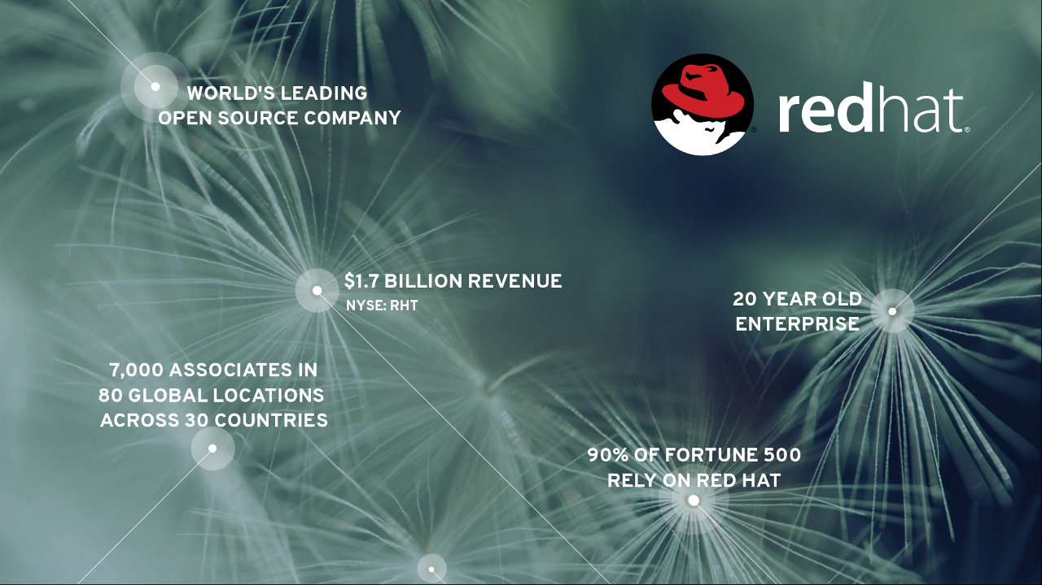
Notes:
Any Red Hat customers?
No sales pitches, promise!

Slide 3
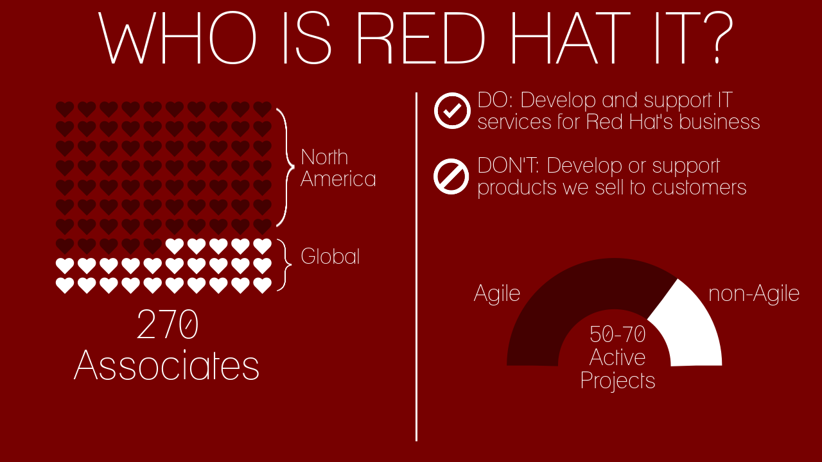
Notes:
Relate to audience: “Trust me, we have all the same types of challenges running the IT back office that all you other horses have. Met a lady at a neighborhood kid’s birthday party, told her I worked at Red Hat. She asked what I did at Red Hat and I said ‘I work in IT.’ She said, ‘I know what Red Hat does, but what do you do there?’” (etc. etc. who’s on first joke)
Source image: https://magic.piktochart.com/editor/piktochart/2855632#

Slide 4

Birth of a DevOps Initiative
Notes:
CIO initiated IT re-org, Fall 2013 roll-out
Process, Cloud, and Customer Engagement goals
Sizeable: 70% of org
CIO goal: “Scare the business” with IT agility
Created a dedicated “DevOps Enablement” team, “Inception”
PAINT PICTURE
Time of great excitement, wonder, and FUD
Mostly recruited from inside, team couldn’t wait to get started
Needed to draft a Charter, think about how we’ll organize & plan

Slide 5
The Dedicated Team
CIO
OCIO
Regional IT
IT Enablement
Enterprise Dev
LOB Dev
Ops
SysEng
“Inception”
EA
InfoSec
Bill / Mgr (Ops)
Ryan / Eng (SysAdmin)
Jen / PO (Prgm mgmt)
Tim / Eng (Release Eng)
Steve / Eng (InfoSec & Dev)
Chris / Eng (SysAdmin)
Notes:
QUICK
dedicated team
2-year charter
reports alongside IT ops & governance functions
CLICK
recruited diverse backgrounds--all but one insiders

Slide 6
Mission
Enable IT to improve Red Hat’s business agility by halving cycle time and doubling frequency of software changes by October 2015
Notes:
two years to experiement
FIRST MISTAKE: NOT our first mission statement - much more hand-wavy; led to 3-4 months of flailing
Original mission statement: “Enable Red Hat IT to effectively deliver high-quality solutions the Open Source way, by cultivating a collaborative culture.”
Didn’t beat ourselves up; this is hard: learn and adapt
Help drive decision making

Slide 7

Strategy
DevOps
Continuous Delivery
Refinement
Release automation
Notes:
DevOps so broad: culture, automation, measurement, sharing
Hit a bit of all w/ CD practices
Assessed where we were:
Humble & Farley Continuous Delivery (WHO KNOWS THIS BOOK?) - maturity model
Complaint Fest (STORY: was opposed, glass half full, team members convinced me, was VERY productive)
Release automation & environment management (provisioning of infra & network + config mgmt / Puppet)

Slide 8
Where to begin?
ERP apps
SaaS apps
“Packaged” apps
Readiness
Value
Notes:
FASTER - CUT DOWN
Where to apply CD & release automation?
LOB? Particular app?
Desired to create repeatable patterns, not a one-off solution for one app
Created 3 buckets: Proprietary ERP, SaaS, and Package SW
Go over the 2x2

Slide 9
Landing on SOA Services & ESB (“SSE”)
Service Oriented Architecture: APIs into Red Hat’s business
Enterprise Service Bus: app-level communications backbone
Integration point for back-office & front-office apps
At intersection of every major program
Optimize SSE’s delivery to make everything else easier
Notes:
SOA Services == Service Oriented Architecture tier is effectively a set of internal APIs to our Enterprise (pull information on a customer’s subscriptions or retrieve pricing data for a given SKU)
ESB == Enterprise Service Bus is backbone of communication for all our enterprise apps, facilitating data exchange between systems like CRM, subscription management, order-to-cash, and customer support ticket management

Slide 10

Partnership
Notes:
Worked 4 months, SSE & PlatOps, developed in-house tooling for release automation
open sourced – Winternewt (aka “Release Engine”)
Successful POC in July - automated deployment of new SOA nodes to QA environment

Slide 11

Partnership Challenges
Notes:
Enthusiastic sr. manager & capable and willing team, BUT
Mission critical system (SOA tier & ESB)
Pressure from high-profile date-driven program
Vritant: “I just want to release this the old way”
Waterfall program management imposed by “Big Four” firm - impedance mismatch with CI/CD practices
Some success: a few trial QA deploys
Story: 4th of July weekend stuff, shifting dates, etc. etc.
Now branching out - 4+ add’l teams

Slide 12
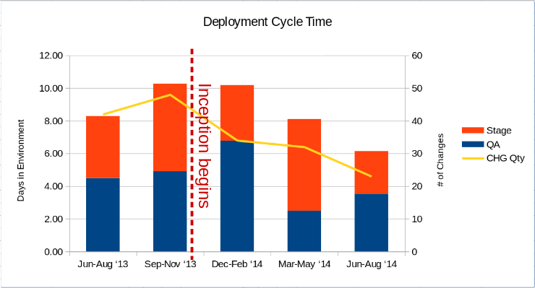
Measuring Progress
Today:
Cycle time
Deployment frequency
Soon:
Change failure rate
MTTR
Notes:
Haven’t fully on-boarded any one team to CD
YET - positive trend
Best guess:
Team existence empowered teams to look at own processes; signaled an organizational priority from top
Unprecedented inter-team sharing - formal forums & ad hoc
Problems:
QTD, back to where we were at the start
Digging deeper – data quality issues
Change manager – believes CHG compliance rates dropping
Witnessing seasonality? Noise?

Slide 13

The Journey
Notes:
Surprise: stress of transitioning from Ops to an Innovation & Change mission
Working on right things?
Will it make a difference?
How to measure
Realistic: Dedicated team still takes time to make progress
You’re working with Dev and Ops teams that still have commitments
Change isn’t easy

Slide 14
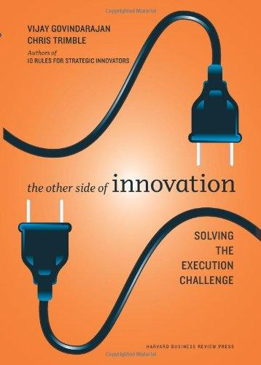
Read this first
Notes:
Innovation project: 1% ideas 99% execution
How to run your initiative with the scientific method
Still integrating these ideas

Slide 15
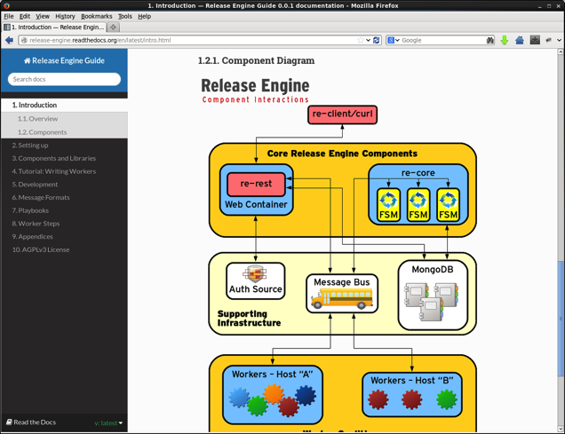
Winternewt (formerly “Release Engine”)
Repeatable, automated deployments
Developed in Red Hat IT
Open Source
https://github.com/RHInception
Modular, extensible

Slide 16

Lessons learned
Worked well
Dedicated team
Agile / iterative approach
Build DevOps from CI/CD practices
Things we learned
Clarify mission early
Create a hypothesis of record and measure against it
Attach to a low-risk project to start
Notes:
Dedicated team:
Greater returns per unit of investment
THANK YOU to my team
Agile / iterative: integrates learning and adjustment into process
PO role gives discipline
CI/CD: gives something concrete to build on
Clarify mission early: flailed for 3-4 months
Hypothesis of record: Still working on this: apply scientific method, rigor; Other Side of Innovation
Attach to low-risk project: Hindsight 20-20, big program seemed like a good idea at the time (some team members “told you so!” but too mature to say it)

Slide 17
Help me!
How do we transition from a 24-month DevOps change initiative to sustained ongoing investment in DevOps?
I want to know your thoughts!
Twitter: @billmvt
Email: bmontgom@redhat.com
Notes:
“Inception” team ends this time next year
Will have made lots of progress but work will not be done
How have you structured ongoing investments in DevOps in your organization? Does it even need to be someone’s day job? We’ve all heard “DevOps is not a team or a title”

Slide 18
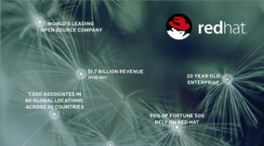
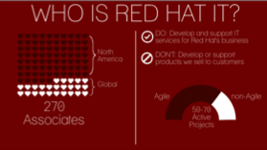
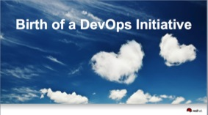
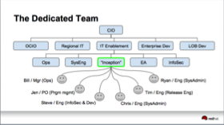
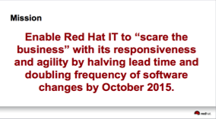
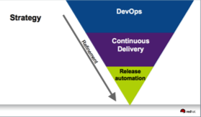
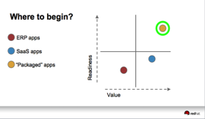


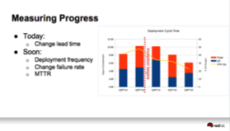

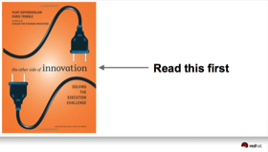
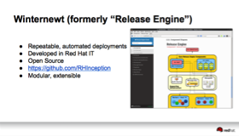

Thank You!
Q&A

